Slide 1


STIX2/TAXII2 Workshop

Slide 2
Contributions
Training materials were provided by (alphabetically ordered)
LookingGlass Cyber Solutions
MITRE
New Context
Symantec
Thank you to all contributors and trainers

Slide 3
Agenda
09:45 – 10:00 STIX/TAXII Overview
10:00 – 11:00 STIX2 Data Model
11:00 – 11:20 STIX2 Patterning Language
11:20 – 11:35 TAXII2 Overview
11:35 – 12:00 STIX2/TAXII2 Developer Resources
12:00 – 12:20 STIX2/TAXII2 Interoperability
12:20 – 12:30 STIX/TAXII 2.1 and Beyond

Slide 4
STIX/TAXII Overview

Slide 5
What is Cyber Threat Intelligence (CTI)?
“(Cyber) Threat Intelligence is evidence-based knowledge (e.g. context, mechanisms, indicators, implications and action-oriented advice) about existing or emerging menaces or hazards to assets”.
Gartner Group (2016)

Slide 6
Why standardize the exchange of CTI?
Enable interoperable sharing of CTI across:
Organizational boundaries
Technology boundaries
Geographic boundaries
Enable efficient and effective automated processing of CTI
Allow automated ingestion, triage, and correlation
Support automated analysis
Enrich CTI streams used by threat analysts

Slide 7
Structured Threat Information Expression
A language for sharing cyber threat intelligence.
JSON language to describe Cyber Threat Intelligence
Designed to facilitate sharing
Active community of developers and analysts
International standard in OASIS
Current version - STIX 2.0

Slide 8
Trusted Automated eXchange of Intelligence Information
A protocol for sharing cyber threat intelligence.
Application protocol running on top of HTTPS
Designed to facilitate sharing of CTI data - especially STIX
Open-source implementations in multiple programming languages
International standard in OASIS
Current version - TAXII 2.0

Slide 9
Historical Timeline
Inception
US Department of Homeland Security begins initiative to develop a standard for cyber threat intelligence exchange
Initial Operational Use
Financial sector begins pilot program to exchange indicators via STIX/TAXII
Development of STIX/TAXII 2.0
CTI TC begins development of the next generation of STIX/TAXII
2013
2015
2017
2012
2014
2016
STIX/TAXII 1.0 Released
First major release of STIX and TAXII
Transition to OASIS
DHS transitions governance of STIX/TAXII to OASIS, an international standards development organization - CTI TC formed
STIX / TAXII 2.0 Published
CTI TC approves “Committee Specifications” for STIX 2.0 and TAXII 2.0. Work begins on STIX 2.1 and TAXII 2.1

Slide 10
STIX2 vs STIX1 Highlights
JSON, not XML: Preferred by developers, easier to understand
Simplicity and Clarity: Less flexibility, more standardization
Pragmatism: Fewer, but better-defined objects and properties and fewer optional properties
One Standard: CybOX merged into STIX
Relationships as first-class objects: Easier for the community to extend
Graph-based data model: Better enables the use of STIX objects in the CTI lifecycle

Slide 11
TAXII 2 vs TAXII1 Highlights
JSON, not XML: Preferred by developers, easier to understand
Built on top of HTTPS: Simplifies protocol by taking advantage of native HTTP capabilities (TAXII1 did not)
RESTful API: Simplifies development of TAXII2 applications

Slide 12
STIX/TAXII Standards Ecosystem
{
Domain Objects & Relationships
STIX
Cyber Observables
Interoperability
Patterning Language
TAXII

Slide 13
Who does what with STIX/TAXII?
Everyone
Do I want to help define STIX / TAXII?
Use STIX/TAXII standards, tools and resources;
build products & certify them
No
Define
STIX/ TAXII standards & Interop tests
OASIS CTI TC members
Yes

Slide 14
OASIS Cyber Threat Intelligence TC
Large: 299 Members (Largest OASIS TC in history)
Broad: Multi-nationals, start-ups, universities, government agencies, consultants
Representative: Financial services, healthcare, software, research, public sector
International: Asia, Australia, Europe, North America
FIRST: Formal liaison relationship with OASIS

Slide 15








































































OASIS CTI TC Members

Slide 16
STIX2 Data Model

Slide 17
Use Cases
Analyzing & Sharing Cyber Threat Intelligence (CTI)
TTPs
Adversary Information
Indicators
Campaigns & Intrusion Sets
Supporting the CTI Lifecycle
Sharing Sightings
Managing Cyber Threat Response Activities
Cyber Threat Prevention
Cyber Threat Detection
Incident Response

Slide 18

STIX2 by the Numbers
STIX 2.0 defines:
12 Domain Objects
2 Relationship Objects
16 Cyber Observable Objects
11 Common Data Types
5 Cyber Observable-specific Data Types
14 Vocabularies
Building blocks for Cyber Threat Intelligence
Image credit: https://isaacmorehouse.com/wp-content/uploads/2015/06/legos1-1024x544.jpg

Slide 19
STIX2 Data Model Design Methodology
Less abstraction, more granularity
For better semantic consistency and interoperability, STIX defines a larger number of more granular domain objects.
Don't reinvent the wheel
STIX leverages widely-used concepts in CTI, like TLP data markings, as much as possible.
Consistent object definitions
Each STIX object has an identical set of common properties for entities like IDs, labels, external references, etc.
Support customization
STIX recognizes that the standard data model doesn't cover everything, and therefore has native support for custom objects and properties.
Support the object lifecycle
STIX includes native support for object versioning and revocation.

Slide 20
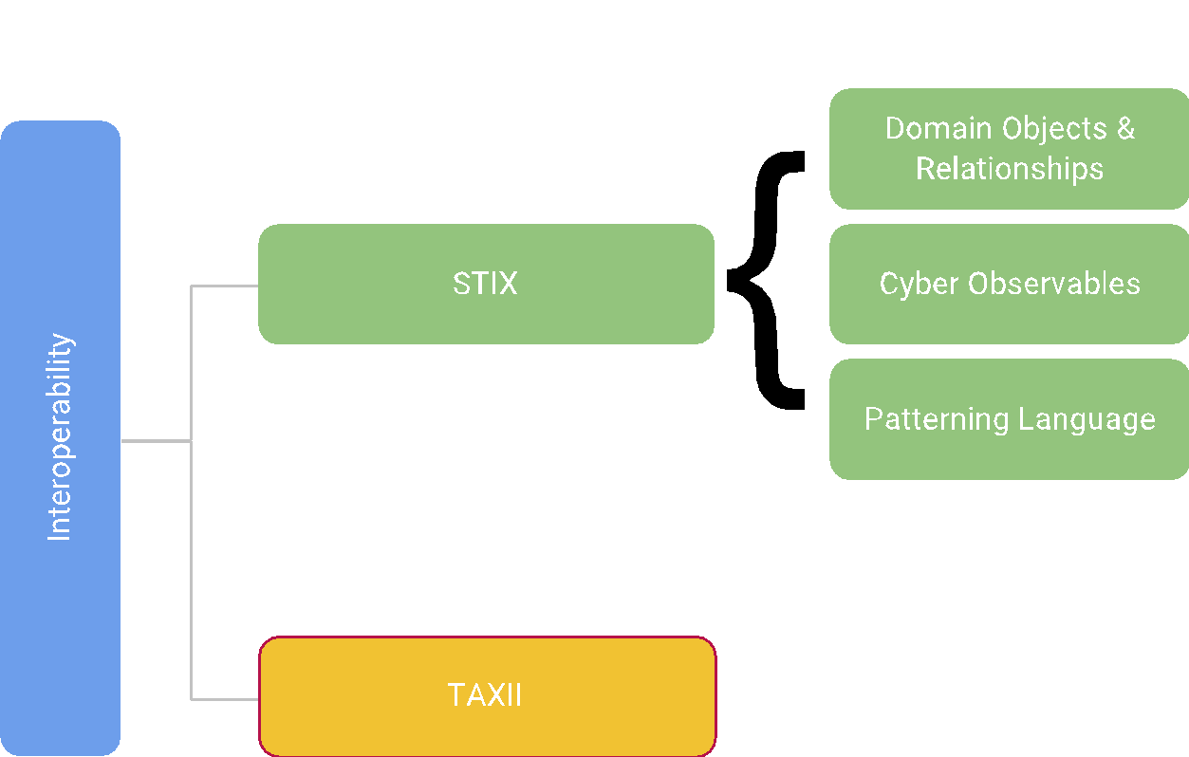
Core STIX2 Concepts
Data model for abstractions such as “threat actor” or “indicator” and the relationships between them
Data model for specific types of observable entities such as IP addresses, domain names, or email metadata
Formal grammar for specifying human/ machine-readable patterns of cyber observables to look for in indicators

Slide 21

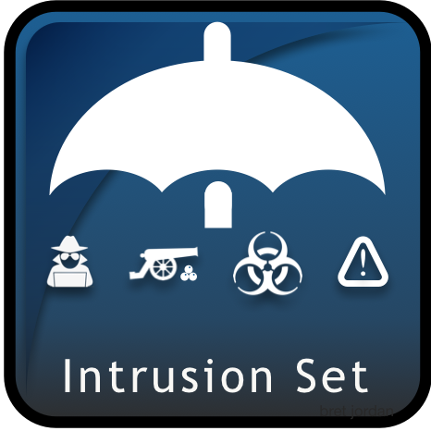

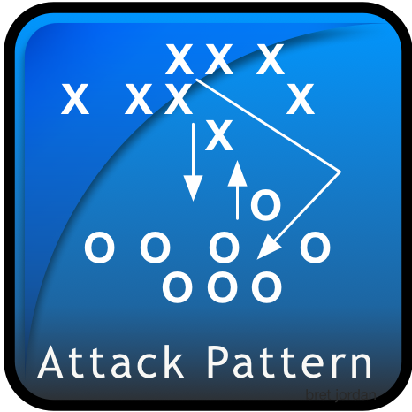








STIX 2.0 Domain Objects (SDOs)
Adversary Objects
TTP Objects
Supporting Objects
Remediation Objects
Detection Objects

Slide 22


STIX 2.0 Relationship Objects (SROs)
Standard Relationship Objects
Special Relationship Objects

Slide 23
STIX 2.0 Cyber Observable Objects
Artifact
AS
Directory
Email Address
Email Message
File
Archive Extension
NTFS File Extension
PDF File Extension
Raster Image File Extension
Windows PE Binary File Extension
IPv4 Address
IPv6 Address
MAC Address
Mutex
Network Traffic
HTTP Request Extension
ICMP Extension
Network Socket Extension
TCP Extension
Process
Windows Process Extension
Windows Service Extension
Software
User Account
UNIX Account Extension
Windows Registry Key
X.509 Certificate

Slide 24
STIX2 Patterns: Basic Examples
Finding an IP
Finding a URL
Finding one of two registry keys
[ip-addr.value = '8.8.8.8']
[url:value MATCHES '^(?:https?:\/\/)?(?:www\.)?example\.com\/.*']
[windows-registry-key:key = 'HKEY_CURRENT_USER\\Software\\CryptoLocker\\Files' OR windows-registry-key:key = 'HKEY_CURRENT_USER\\Software\\Microsoft\\CurrentVersion\\Run\\CryptoLocker_0388']

Slide 25
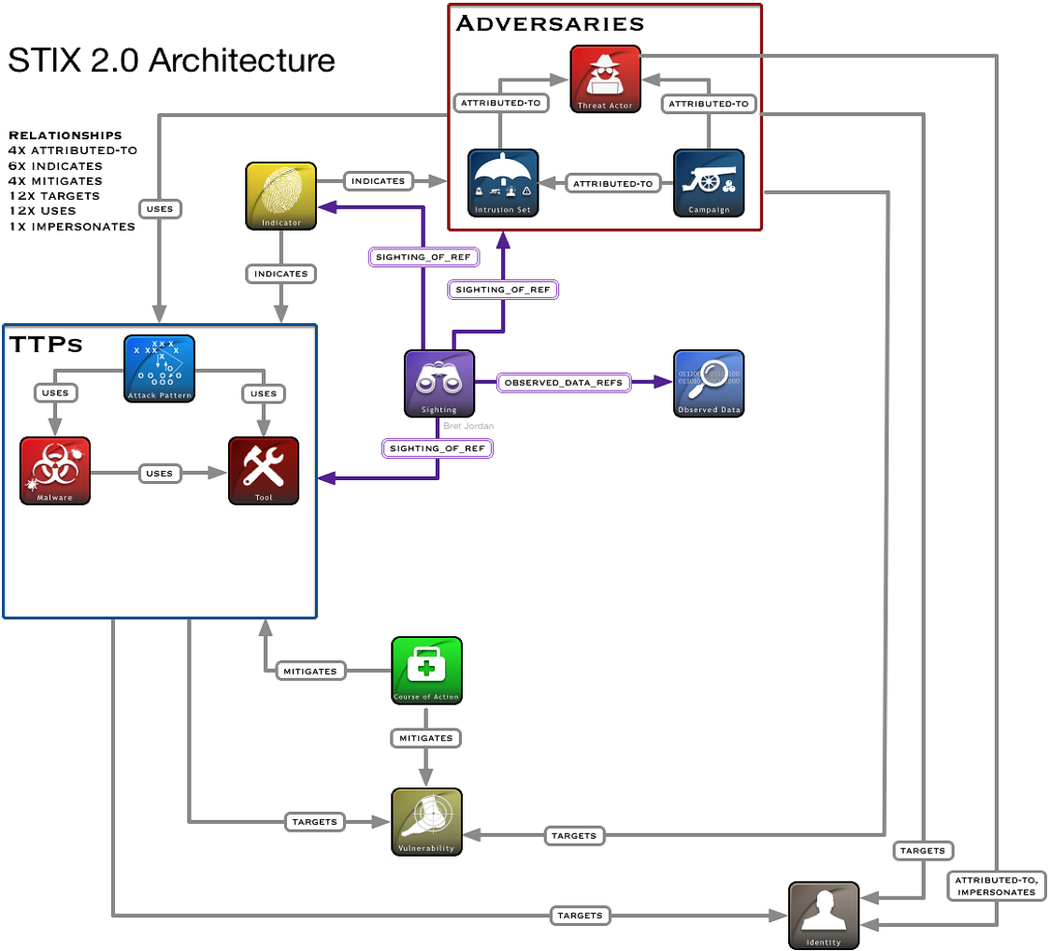

Slide 26
Example: Indicator with Relationships
labels: malicious-activity
pattern: file:hashes.MD5 = 'cead3f77f6cda6ec00f57d76c9a6879f'
name: nmap
description: Used for mapping local networks by adversaries
indicates

Slide 27
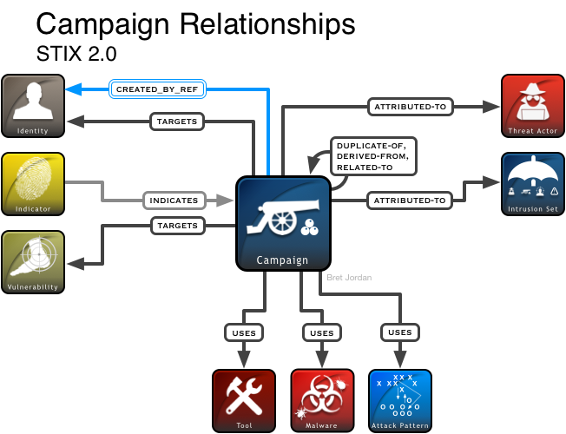
Adversary SDOs: Campaign
A Campaign describes a set of malicious activities that occur over a period of time against a specific set of targets. These activities usually are composed of specific behaviors, have well defined objectives, and may be part of an Intrusion Set.
Examples
Campaign by Green Group against a set of targets in the financial services sector
Campaign by Red Group against a set of targets in the critical infrastructure sector and leveraging the BadNewz Malware Family

Slide 28
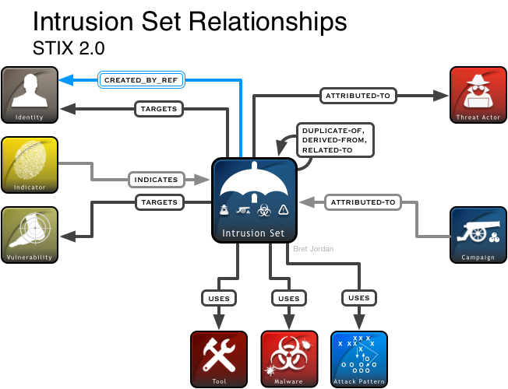
Adversary SDOs: Intrusion Set
An Intrusion Set is a grouped set of adversarial behaviors and resources with common properties that is believed to be orchestrated by a single organization. They may capture multiple Campaigns that are all tied together by shared attributes indicating a common Threat Actor.
Examples
A set of Campaigns perpetrated over multiple years by the same Threat Actor in order to achieve a diverse set of objectives

Slide 29
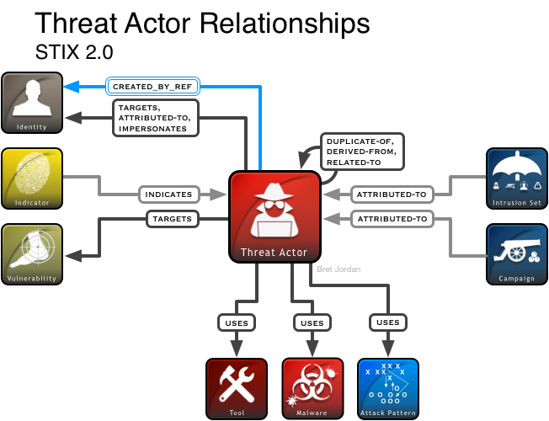
Adversary SDOs: Threat Actor
Threat Actors are actual individuals, groups, or organizations believed to be operating with malicious intent.
Examples
Evil Org, an organization
John Doe, a malware author associated with Evil Org and several other criminal groups

Slide 30
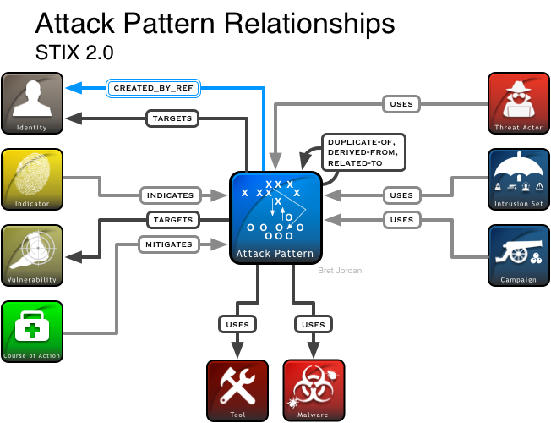
TTP SDOs: Attack Pattern
Attack Patterns describe ways that adversaries attempt to compromise targets. They’re used to help generalize specific attacks to the patterns that they follow and provide detailed information about how attacks are performed.
Examples
Spear Phishing (generic)
Spear Phishing as practiced by APT3
Privilege Escalation
DLL Injection
UDP Flood
DNS Spoofing

Slide 31
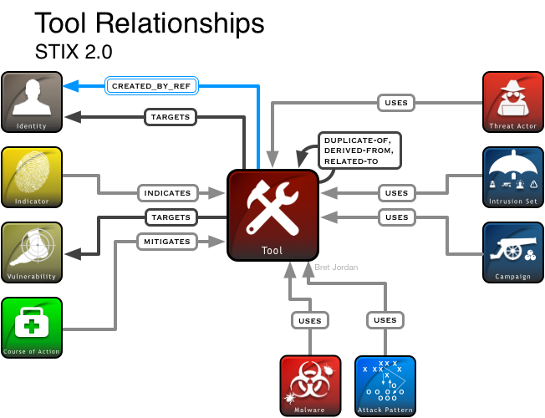
TTP SDOs: Tool
Tools are legitimate software (and therefore distinct from malware) that can be used by threat actors to perform attacks.
Examples
nmap, used by Threat Actor Foo for network mapping
netcat, used by Threat Actor Bar for TCP tunneling

Slide 32
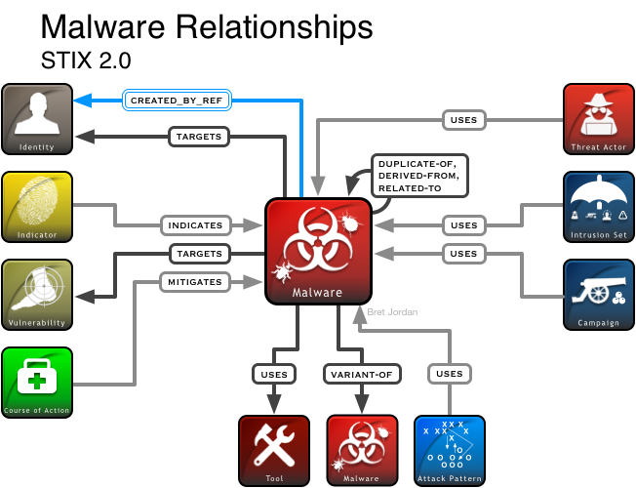
TTP SDOs: Malware
Malware characterizes Malware Instances or Malware Families, including identifying information, metadata, and data that may be derived from various forms of malware analysis.
Examples
Poison Ivy (Malware Family)
Trojan.Zeus.AZ (Malware Instance)

Slide 33
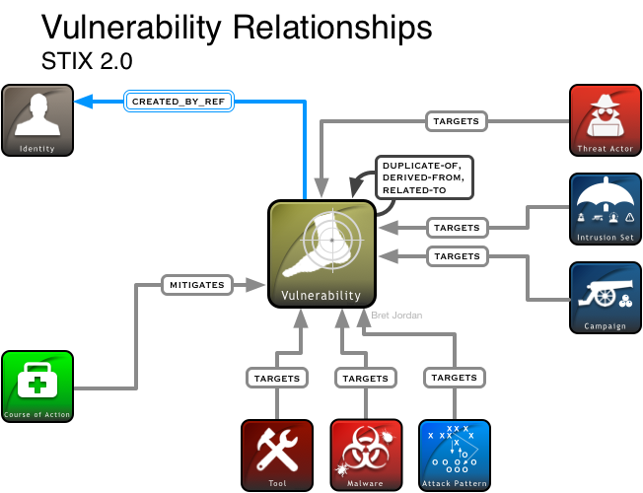
TTP SDOs: Vulnerability
A Vulnerability is, according to CVE, "a mistake in software that can be directly used by a hacker to gain access to a system or network”.
Examples
A Malware Instance exploits a Vulnerability identified as CVE-2015-12345
Campaign Foo is known to target a specific Vulnerability for exploitation

Slide 34
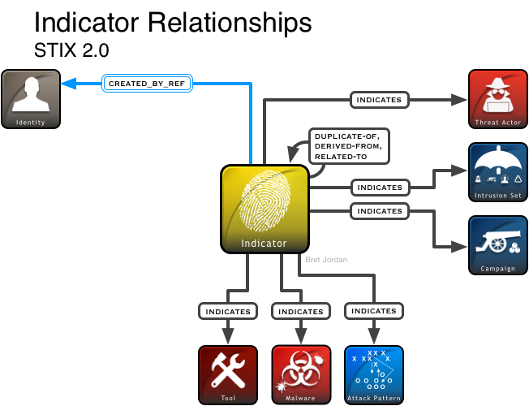
Detection SDOs: Indicator
Indicators contain a pattern that can be used to detect suspicious or malicious cyber activity. They use the STIX Patterning Language for specifying the actual syntax and content of the patterns.
Examples
A SHA-256 hash that detects a particular Malware Instance
An email address that detects attempted Spear Phishing by a particular Campaign

Slide 35
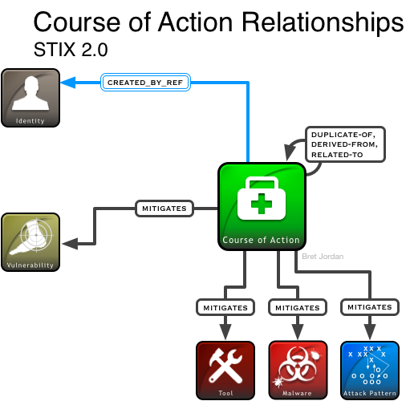
Remediation SDOs: Course of Action
A Course of Action is an action taken either to prevent an attack or to respond to an attack that is in progress. It may describe technical, automatable responses or higher level actions like employee training or policy changes.
Examples
Adding a new TCP Filter rule to a Firewall
Quarantining all files associated with a particular Malware Family
Applying a particular software patch

Slide 36
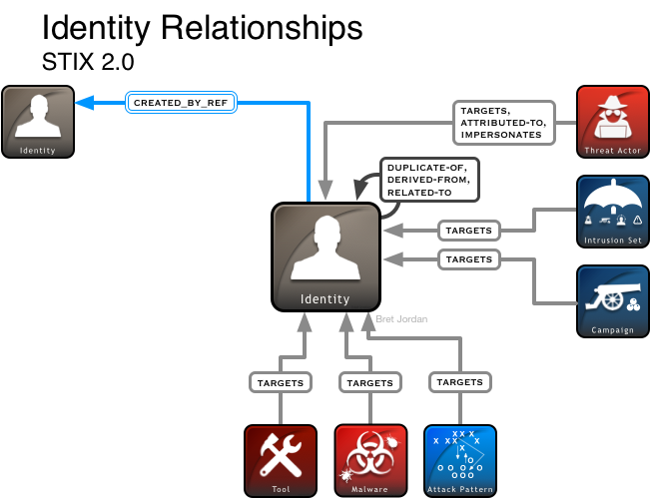
Supporting SDOs: Identity
Identities can represent actual individuals, organizations, or groups as well as classes of individuals, organizations, or groups.
Examples
An Individual named John Smith
A Company named ACME, Inc.
The Healthcare Industry Sector

Slide 37
Supporting SDOs: Observed Data
Observed Data conveys information that was observed on systems and networks, and makes use of the data models developed as part of STIX Cyber Observables for characterizing this information.
Examples
Relationships
An Observation of a particular File, as represented a File Object with a set of hashes and a file name
An Observation of a particular domain name of unknown provenance, as represented by a Domain Name Object
N/A – there are no top-level relationships between the Observed Data Object and other Objects.
Instead, Observed Data is a direct target of the Sighting STIX Relationship Object.

Slide 38
Supporting SDOs: Report
Reports are collections of threat intelligence focused on one or more topics. They are used to group related threat intelligence together so that it can be published as a comprehensive cyber threat story.
Examples
Relationships
A Report produced by ACME Defense, Inc. about the Purple Gorilla Campaign
N/A – there are no top-level relationships between the Report Object and other Objects.
Instead, the Report Object has an embedded relationship that can point to any STIX Object.

Slide 39
STIX Relationship Object: Sighting
STIX Relationship Object (SRO) used to report observations of SDOs, usually (but not necessarily) Indicators
Examples
Relationships
That indicator was seen
That indicator was seen by an organization in the energy sector in San Antonio, Texas
That indicator was seen by IBM
That indicator was seen, and here’s a network traffic dump
That intrusion set was seen 3 times by organizations in the defense sector in the United States
This is a summary sighting of an indicator that was seen 426 times between 1/1/18 and 1/31/18 in the finance sector.
sighting-of-ref
(required)
(any SDO allowed)
where-sighted-refs
(optional)
observed-data-refs
(optional)

Slide 40
Example: Threat Actor with Relationships
name: Adversary Bravo
labels: spy, criminal
description: Known to use phishing attacks to deliver remote access malware to targets.
attributed-to
uses
uses
name: Adversary Bravo Identity
labels: crime-syndicate
description: A threat actor that utilizes phishing attacks.
name: Phishing
external_references:
source_name: CAPEC
description: Phishing
external_id: CAPEC-98
name: PoisonIvy Variant C6
labels: remote-access-trojan
kill-chain-phases:
phase-name: initial-compromise

Slide 41
Example: Campaign with Relationships
name: Blue Group Attacks on Small Banks
description: Campaign by Blue Group against a set of small, local banks.
objective: Stealing customer account information in order to perform fraudulent wire transfers.
attributed-to
targets
name: Blue Group
labels: crime-syndicate
name: First Bank of Foovania
identity_class: organization
sectors: financial-services
attributed-to
name: Blue Group Identity
identity_class: group

Slide 42
Q&A

Slide 43
Modeling Threat Intelligence in STIX2

Slide 44
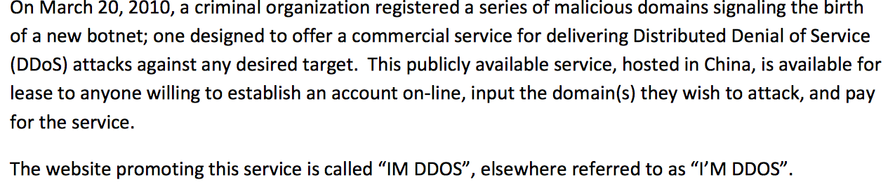
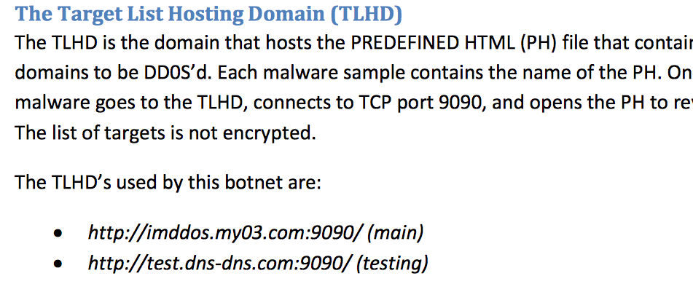
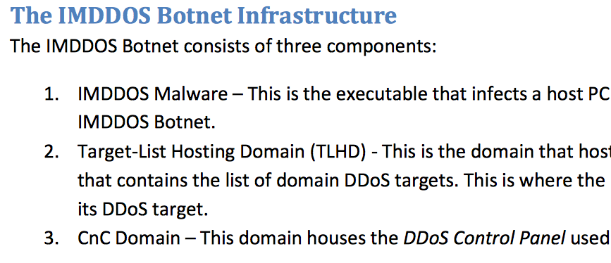
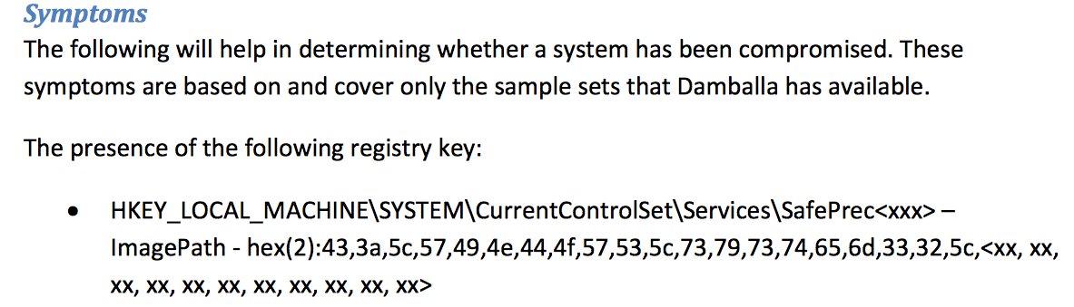
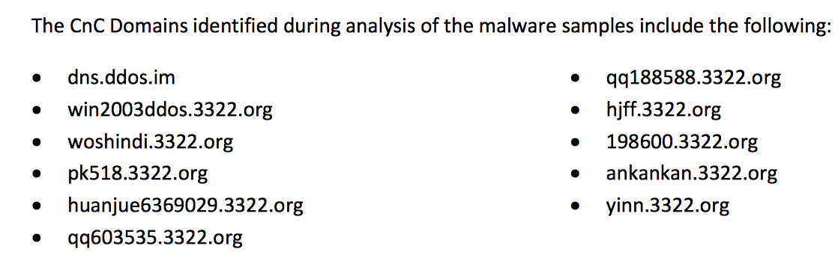
The IMDDOS Report
https://www.coresecurity.com/publication/imddos-botnet-discovery-and-analysis
Report content Copyright 2010, Damballa, Inc,

Slide 45
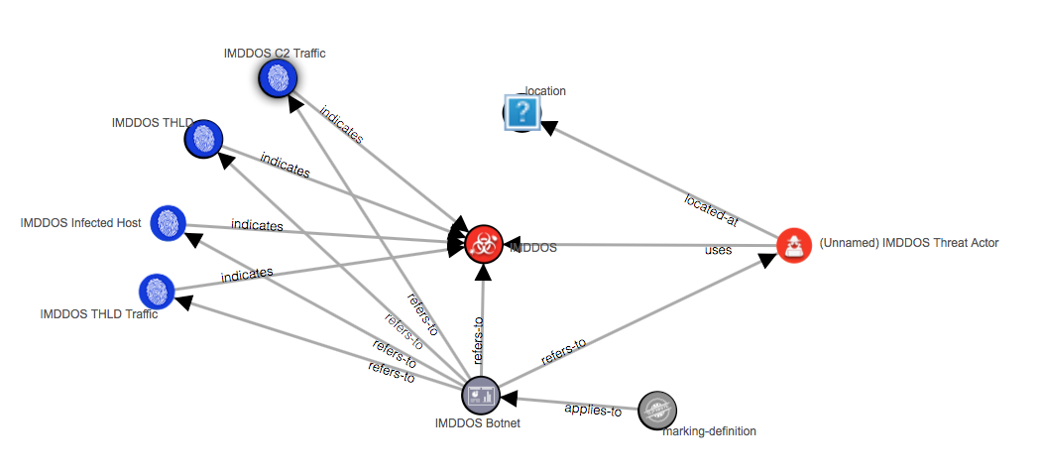

IMDDOS: The Big Picture*
China
* Created directly from the JSON via the STIX Viewer: https://oasis-open.github.io/cti-stix-visualization/

Slide 46
Report
Description: "The newly-uncovered IMDDOS Botnet is a commercial DDOS service hosted in China."
Timestamps
Marking Definitions: "Copyright 2010, Damballa, Inc All Rights Reserved"
External References: "https://www.coresecurity.com/system/files/publications/2017/03/Damballa_Report_IMDDOS.pdf"
Object References

Slide 47
Malware
Name: "IMDDOS"
Description: "Once infected with this malware, a host becomes part of the IMDDOS Botnet"
Labels: "bot","ddos"
Kill chain phases: "exploit"

Slide 48
Threat Actor & Location
Name: "(Unnamed) IMDDOS Threat Actor"
Labels: "criminal"
Region: "China"

Slide 49
Indicator: THLD
Name: "IMDDOS THLD"
Labels: "malicious-activity"
Description: "References to this domain are indicative of the presence of the IMDDOS malware in the environment"
Pattern: "[ domain-name:value = 'imddos.my03.com' ]"

Slide 50
Indicator: THLD Traffic
Name: "IMDDOS THLD Traffic"
Labels: "malicious-activity"
Description: "Traffic to this domain indicates the source host is infected with IMDDOS malware"
Pattern: "[ network-traffic:dst_ref.type = 'domain-name' AND network-traffic:dst_ref.value = 'imddos.my03.com' AND network-traffic:dst_port = 9090 ]"

Slide 51
Indicator: IMDDOS Infected Host
Name: "IMDDOS Infected Host"
Labels: "malicious-activity"
Description: "Presence of this registry key on a host indicates it is infected with the IMDDOS malware"
Pattern: "[windows-registry-key:key LIKE 'HKEY_LOCAL_MACHINE\\System\\CurrentControlSet\\Services\\SafePrec%' ]"

Slide 52
Indicator: IMDDOS C2 Traffic
Name: "IMDDOS C2 Traffic"
Labels: "malicious-activity"
Description: "Traffic to these domains indicates that the source host is under the control of the IMDDOS malware"
Pattern: "[ network-traffic:dst_ref.type = 'domain-name' AND network-traffic:dst_ref.value IN ('dns.ddos.im', 'win2003ddos.3322.org', 'woshindi.3322.org', 'pk518.3322.org', 'huanjue6369029.3322.org', 'qq603535.3322.org', 'qq188588.3322.org', 'hjff.3322.org', '198600.3322.org', 'ankankan.3322.org', 'yinn.3322.org') ]"

Slide 53
Some Resources for Modeling
STIX2 JSON for IMDDOS: https://gist.github.com/rjsmitre/79775df68b0d1c7c0985b4fe7f115586
CTI Whittler: takes simplified YAML input, generates valid STIX2 JSON along with visualization in real time. Very useful for experimentation
Live instance: https://johnwunder.github.io/cti-whittler
Source code: https://github.com/johnwunder/cti-whittler
STIX2 Viewer: Simple visualization tool for STIX2 data
Live instance: https://oasis-open.github.io/cti-stix-visualization
Source code: https://github.com/oasis-open/cti-stix-visualization
STIX2 Quick Reference card decks (special thanks to EclecticIQ for providing these handouts.)
STIX2 Patterning Quick Reference sheets: https://goo.gl/3vMk9m (special thanks to New Context for providing these handouts.)

Slide 54
Q&A

Slide 55
STIX2 Object Structure

Slide 56
STIX2 Object Anatomy
type: "indicator",
spec_version: "2.0",
id: "indicator--8e2e2d2b-17d4-4cbf-938f-98ee46b3cd3f",
created: "2016-04-06T20:03:48.000Z",
modified: "2016-04-06T20:03:48.000Z”
labels: ["malicious-activity"],
pattern: "[file:hashes.'SHA-256' = '4bac27393bdd9777ce02453256c5577cd02275510b2227f473d03f533924f877' ]",
valid_from: "2016-01-01T00:00:00Z"
Common Object
Properties
Object Versioning
Properties
Object-specific
Properties

Slide 57

Versioning & Relationships
One of the key benefits of STIX 2.0 versioning and relationships is that it allows multiple users to reference STIX Objects without necessitating a new version of the object
name: Blue Group
labels: crime-syndicate
Created By
Foo Org₁
uses
uses
Created By
Created By
Joe Analyst
MetaCortex Corp.
name: PoisonIvy Variant C6
name: Cryptolocker
1- Image credit: https://openclipart.org/detail/247319/abstract-user-icon-3

Slide 58
Object Relationships
Each SDO has its own set of relationship types. For example, the “indicates” relationship is defined for the Indicator SDO:
In addition, STIX defines several relationships that are common to all Objects:
derived-from: the information in the target object is based on information from the source object.
duplicate-of: the referenced source and target objects are semantically duplicates of each other.
related-to: the referenced source and target objects are somehow related to each other.
indicates

Slide 59
Object Versioning: Concepts
Objects may have new versions defined only by their Object Creator
Object Creator: the entity (e.g., system, organization, instance of a tool) that generates the id property for a given object. Object creators are represented as Identity objects.
Producers other than the Object Creator are not allowed to create new versions of an Object, and instead must create a new Object (with a new id).
Reasons for versioning an existing Object:
Updating existing information
Adding new information
Removing information
Objects may also be revoked by setting the revoked property to true
This is permanent – once an Object has been marked as revoked, future versions MUST NOT be created.

Slide 60
STIX2 Data Markings
Allows object creators to attach restrictions, permissions, and other guidance or how object data can be used and shared
STIX 2.0 defines two types of markings that can be applied:
Traffic Light Protocol (TLP) markings
TLP: RED, TLP: AMBER, TLP: GREEN, TLP: WHITE
Statement markings, e.g. copyright notices, licenses, disclaimers
Markings can be applied at two different granularities:
Object: the marking applies to the entire object
Granular: the marking applies to the named properties (allows specifying element subsets for list properties)

Slide 61
Object vs Granular Data Markings
"type": "threat-actor",
"id": "threat-actor--e234c322-0981-4aa4-ae03-f4037e6be83f",
"created": "2017-07-18T22:00:30.405Z",
"modified": "2017-07-18T22:00:30.405Z",
"name": "(Unnamed) IMDDOS Threat Actor",
"description": “IMMDOS is believed be be the work of…",
"labels": [ "criminal" ]
Object-level Marking:
TLP:GREEN
Granular
Markings:
TLP:AMBER
TLP:RED
"type": "threat-actor",
"id": "threat-actor--e234c322-0981-4aa4-ae03-f4037e6be83f",
"created": "2017-07-18T22:00:30.405Z",
"modified": "2017-07-18T22:00:30.405Z",
"name": "(Unnamed) IMDDOS Threat Actor",
"description": "IMMDOS is believed be be the work of…",
"labels": [ "criminal" ]

Slide 62
Customization and Extension
STIX includes the flexibility to expand the language to address additional use cases
type: "x-foo-com-custom-object"
spec_version: "2.0"
id: "x-foo-com-custom-object--34098fce-860f"
created: "2016-08-01T00:00:00.000Z"
modified: "2016-08-01T00:00:00.000Z"
custom_property_1: "foo"
custom_property_2: "bar"
Custom properties (STIX and Cyber Observables)
Allows you to add additional properties onto existing objects
Custom objects (STIX and Cyber Observables)
Allows you to create entirely new objects that aren’t currently defined
Custom Object Extensions (Cyber Observables only)
Allows you to create a set of properties that are related to an observable object that already exists
Example Custom Object
type: "indicator"
spec_version: "2.0"
id: "indicator--129a0d3b-471c"
created: "2016-08-01T00:00:00.000Z"
modified: "2016-08-01T00:00:00.000Z"
x_acme_org_threatiness: 2.34
Example Custom Property

Slide 63
Q&A

Slide 64
STIX2 Patterning Language

Slide 65
STIX2 Patterning: Overview
Formal grammar for specifying human/ machine-readable patterns of cyber observables to look for in indicators
Designed to support patterns that match against both host-based and network artifacts
Simple things are simple
Complex things are possible
Supports sequencing and temporal patterns

Slide 66
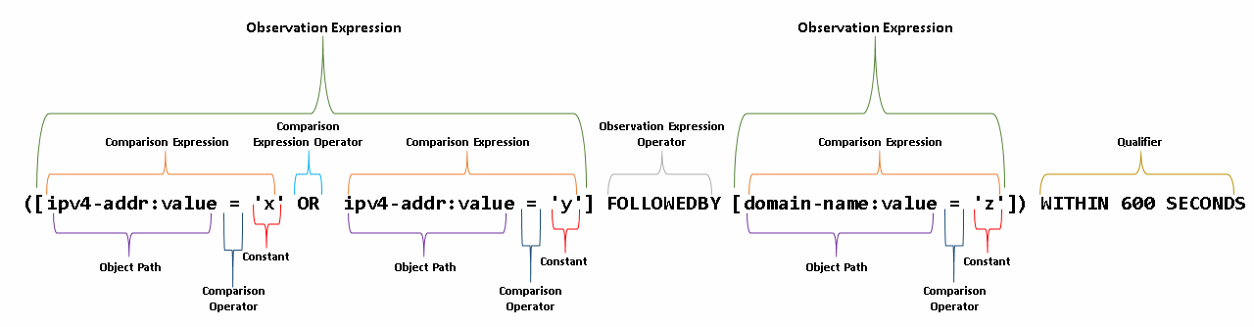
Example: Basic Structure of a STIX2 Pattern
Notes:
A pattern consists of one or more observation expressions joined by observation operators.
Valid observation operators are AND, OR, and FOLLOWEDBY
Each one of those observation expressions may be a simple test (eg. ip-addr.value = '1.2.3.4'), or may be multiple tests that create a comparison expression.
Comparisons within an expression are separated by comparison operators.
There are several comparison operators, including things like =, >, <, IN, LIKE, etc.
An entire observation expression MAY be followed by a qualifier, such as 'REPEATS X TIMES' or 'WITHIN Y SECONDS'.

Slide 67
More Complex Example: Necurs Botnet
Looks for a particular malware payload followed by HTTP beaconing traffic generated by the payload:
[file:name = 'rekakva32.exe' AND file:parent_directory_ref.path MATCHES 'C:\\Users\\[\\w\\s]+\\AppData\\Local\\Temp'] FOLLOWEDBY [network-traffic:protocols[*] = 'http' AND network-traffic:extensions.'http-request-ext'.request_method = 'post' AND network-traffic:extensions.'http-request-ext'.request_header.'User-Agent' = 'Windows-Update-Agent']
Source: https://isc.sans.edu/forums/diary/Necurs+Botnet+malspam+pushes+Locky+using+DDE+attack/22946/

Slide 68
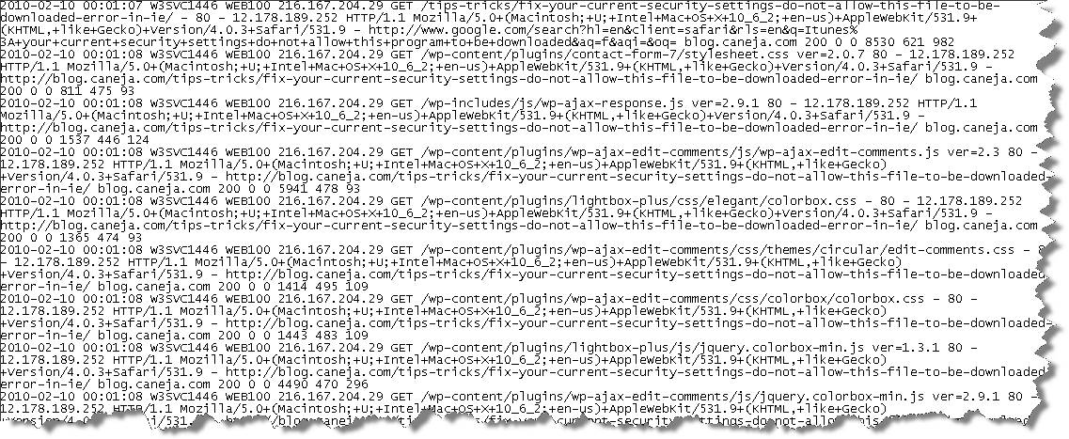
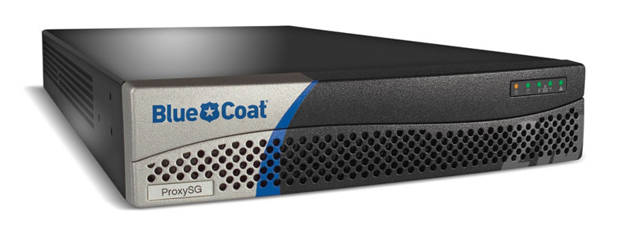
[url:value MATCHES '^(?:https?:\/\/)?(?:www\.)?example\.com\/.*']
Pattern may need to be converted to native query syntax if the security tool does not support STIX Patterning natively.
TIG
(Threat Intelligence Gateway)

Slide 69

[file:hashes.'SHA-256' = 'bf07a7fbb825fc0aae7bf4a1177b2b31fcf8a3feeaf7092761e18c859ee52a9c' AND network-traffic:protocols[*] = 'http' AND network-traffic:extensions.'http-request-ext'.request_method = 'post' AND network-traffic:extensions.'http-request-ext'.request_header.'User-Agent' = 'Windows-Update-Agent']
With security tools that have limited visibility on certain observable types, the Pattern may need to be split into subsets prior to evaluation.
host-based
network-based

Slide 70
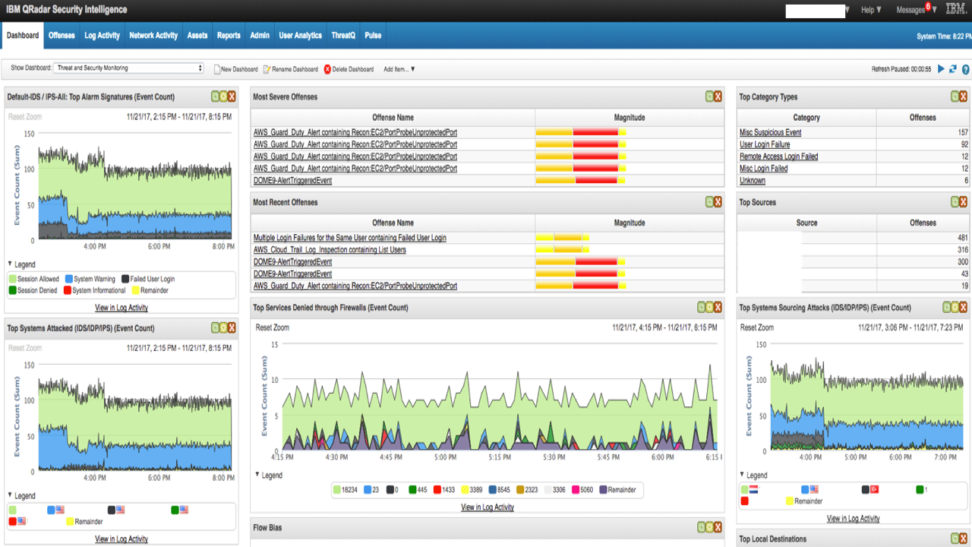
[file:hashes.'SHA-256' = 'bf07a7fbb825fc0aae7bf4a1177b2b31fcf8a3feeaf7092761e18c859ee52a9c' AND network-traffic:protocols[*] = 'http' AND network-traffic:extensions.'http-request-ext'.request_method = 'post' AND network-traffic:extensions.'http-request-ext'.request_header.'User-Agent' = 'Windows-Update-Agent']
With security tools like a SIEM, all of the observable types may be available to evaluate a complex pattern within a single context.

Slide 71
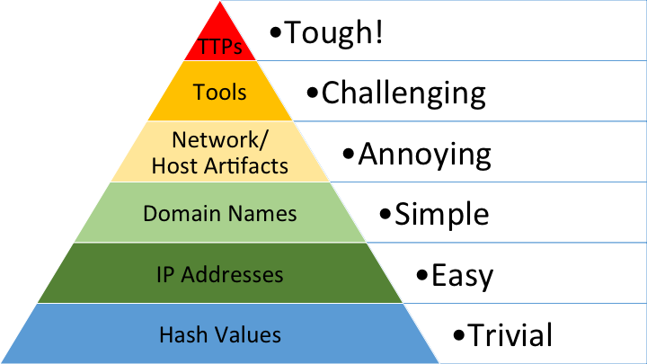
STIX2 Patterning: The Vision
}
Long-term goal for STIX Patterning
}
What most people are doing today

Slide 72
Q&A

Slide 73
TAXII2 Overview

Slide 74
What is TAXII2?
TAXII 2.0: A protocol for sharing cyber threat intelligence.
Uses HTTPs (TLS 1.2 or higher) with RESTful API design
Currently supports sharing CTI via Collections
Allow for sets of STIX2 content to be published, subject to trustgroup ACLs and/or sorted by arbitrary criteria

Slide 75
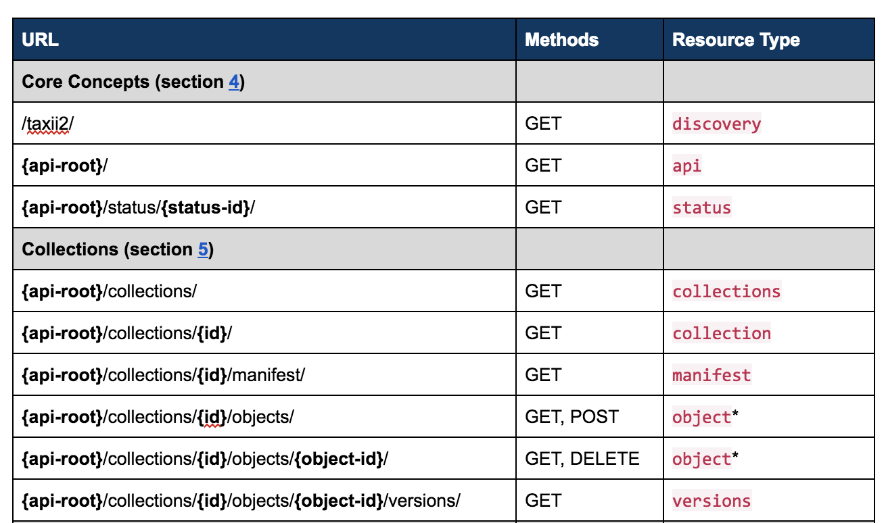
TAXII API Endpoints Summary

Slide 76
Server Discovery: Get server information and a list of API Roots
Request: GET https://ts01.example.com/taxii2/
Response: {
"title": "Some TAXII Server",
"description": "This TAXII Server contains a listing of...",
"contact": "string containing contact information",
"default": "https://example.com/api2/",
"api_roots": [
"https://example.com/api1/",
"https://example.com/api2/",
"https://example.net/trustgroup1/"
]
}

Slide 77
Get information about an API Root
Request: GET https://ts01.example.com/api1/
Response: {
"title": "Malware Research Group",
"description": "A trust group setup for malware researchers",
"versions": [
"application/taxii+json;version=2.1”
],
"max_content_length": 104857600
}

Slide 78
Get a list of available collections
Request: GET https://ts01.example.com/api1/collections/
Response:
{
"collections": [
<list of collection resources>
]
}

Slide 79
Get details about a specific collection
Request: GET https://ts01.example.com/api1/collections/91a7b528-80eb-42ed-a74d-c6fbd5a26116/
Response:
{
"id": "91a7b528-80eb-42ed-a74d-c6fbd5a26116",
"title": "High Value Indicator Collection",
"description": "This data collection contains high value IOCs",
"can_read": true,
"can_write": false,
"media_types": [
"application/stix+json;version=2.1”
]
}

Slide 80
Get summary info (manifest) about a collection
Request: GET https://ts01.example.com/api1/collections/91a7b528-80eb-42ed-a74d-c6fbd5a26116/manifest/
URL Filtering Parameters
added_after - a timestamp (?added_after=...)
id - an id of an object (?match[id]=...)
type - the type of an object (?match[type]=...)
version - the version of an object (?match[version]=...)

Slide 81
Get summary info (manifest) about a collection, con't
Response:
{
"objects": [
{
"id": "indicator--29aba82c-5393-42a8-9edb-6a2cb1df070b",
"date_added": "2016-11-01T03:04:05Z",
"version": "2016-11-03T12:30:59.000Z",
"media_type": "application/stix+json;version=2.1”
} ]
}

Slide 82
GET Objects from a collection
Request: GET https://ts01.example.com/api1/collections/91a7b528-80eb-42ed-a74d-c6fbd5a26116/objects/
URL Filtering Parameters
added_after - a timestamp (?added_after=...)
id - an id of an object (?match[id]=...)
type - the type of an object (?match[type]=...)
version - the version of an object (?match[version]=...)

Slide 83
GET Objects from a collection, con’t
Response:
{
"type": "bundle",
...
"objects": [
{
"type": "indicator",
...
}
]
}

Slide 84
GET Object by ID
Request: GET https://ts01.example.com/api1/collections/91a7b528-80eb-42ed-a74d-c6fbd5a26116/objects/indicator--252c7c11-daf2-42bd-843b-be65edca9f61/
Response:
{
"type": "bundle",
...
"objects": [
{
"type": "indicator",
"id": "indicator--252c7c11-daf2-42bd-843b-be65edca9f61",
...
}
]
}

Slide 85
Posting Data to a Collection - POST
Request: POST https://ts01.example.com/api1/collections/8c99d7d2-8a6c-4196-b216-c1692d0126f2/objects/
Contents:
{
"objects": [ {
"type": "indicator",
"id": "indicator--12fd1bad-8306-4ed4-8c9b-7dfdd8ad5eb8",
"name": "Bad IP1",
"description": "STIX/TAXII 2.0 Interoperability Part 1, §2.2.3.1,​Indicator IPv4 Address",
"created": "2018-01-17T11:11:13.000Z",
"modified": "2018-01-17T11:11:13.000Z",
"valid_from": "2018-01-01T00:00:00.000Z",
"labels": ["malicious-activity"],
"pattern": "[ipv4-addr:value = '198.51.100.1']"
}
]
}

Slide 86
Posting Data to a Collection - POST RESPONSE
Request: POST RESPONSE
{
"id": "2d086da7-4bdc-4f91-900e-d77486753710",
"status": "complete",
"request_timestamp": "2016-11-02T12:34:34.12345Z",
"total_count": 1,
"success_count": 1,
"successes": [
"List of objects defined in the Part1 bundle test cases"
],
"failure_count": 0,
"pending_count": 0
}

Slide 87
Q&A

Slide 88
STIX2/TAXII2 Developer Resources

Slide 89
Open Source Libraries and Tools
There are a bunch of open-source tools and libraries for STIX2/TAXII2.
Implemented in Python, Golang, Java, Scala, Javascript, PHP, etc.
Comprehensive list maintained here: https://goo.gl/y7ru68

Slide 90
Open STIX2 Data Sources
There is a bunch of freely-available STIX2 OSINT for you to play with.
Comprehensive list maintained here: https://goo.gl/kTmvBL

Slide 91
Demo Time!
__________________________________
< Segmentation fault (core dumped) >
----------------------------------
\ ^__^
\ (oo)\_______
(__)\ )\/\
||----w |
|| ||

Slide 92
Q&A

Slide 93
STIX2/TAXII2 Interoperability

Slide 94
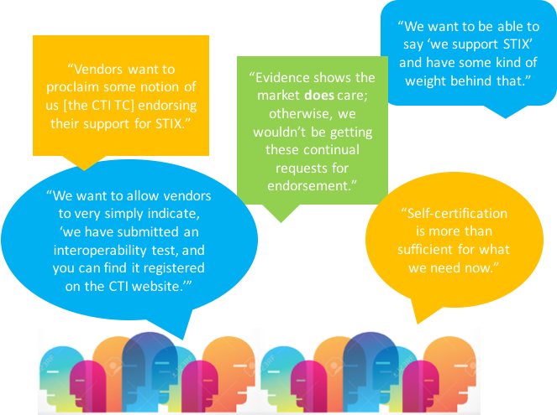


STIX2 / TAXII2 Preferred Certification
OASIS STIX2/TAXII2 Self-certification Program
Increase interoperability of cyber industry products
Increase quality and success of CTI Collaboration
Notes:
<allan primary speaker>
With STIX/TAXII 2 the Interoperability sub-committee is working with OASIS to introduce a new program called STIX Preferred.
This program is a self-certification for organizations that wish to certify their software products as passing the STIX Preferred tests and verification.
The goal is to both promote interoperability and a base level of capabilities across those products and ultimately increase the likelihood of products working together off-the-shelf when deployed to share CTI.
Org will likely be interested in 1 of 2 STIX Preferred Badges.
<explain the badge difference>
<seque> So lets share a few more details on the interoperability program. Allan keeps talking on next slide.

Slide 95
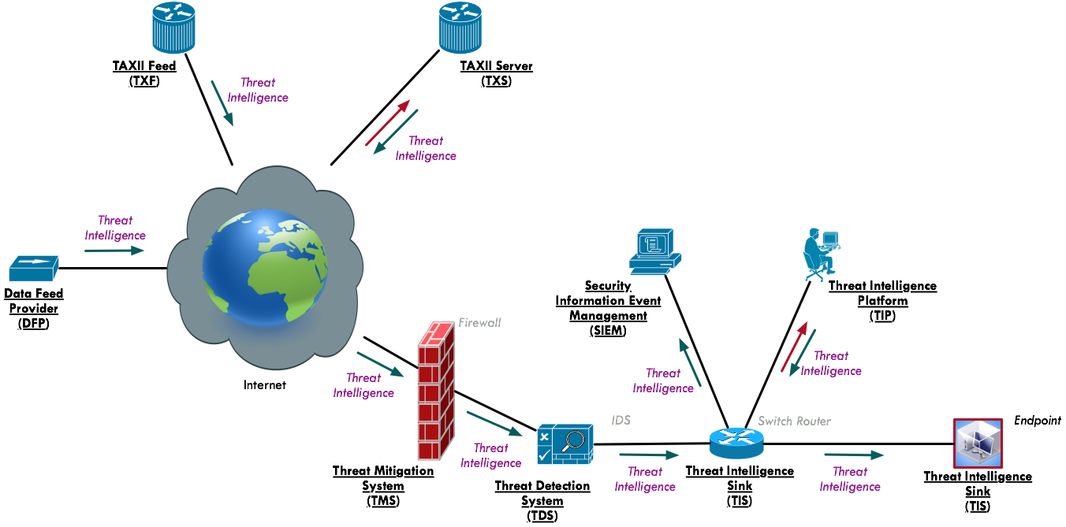
STIX2 / TAXII2 Preferred - Personas
Data Feed Provider (DFP)
Threat Intelligence Platform (TIP)
Security Incident and Event Management (SIEM)
TAXII Server (TXS)
TAXII Feed (TXF)
Threat Mitigation System (TMS)
Threat Detection System (TDS)
Threat Intelligence Sink (TIS)
Notes:
<allan speaker>
Data Feed Provider (DFP)
Software instance that acts as a producer of STIX 2.0 content
Threat Intelligence Platform (TIP)
Software instance that acts as a producer and/or Respondent of STIX 2.0 content primarily used to aggregate, refine and share intelligence with other machines or security personnel operating other security infrastructure
Security Incident and Event Management system (SIEM)
Software instance that acts as a producer and/or Respondent of STIX 2.0 content. A SIEM that produces STIX content will typically create incidents and indicators. A SIEM that consumes STIX content will typically consume sightings, indicators
TAXII Server (TXS)
Software instance that acts as a TAXII Server enabling sharing between producers and respondents of STIX 2 content
TAXII Feed (TXF)
Software instance that publishes STIX content from a road-only TAXII Server
Threat Mitigation System (TMS)
Software instance that acts on course of actions and other threat mitigations such as a firewall or IPS, Endpoint Detection and Response (EDR) software, etc
Threat Detection System (TDS)
Software instance of any network product that monitors and/or detects such as Intrusion Detection Software (IDS), Endpoint Detection and Response (EDR) software, web proxy, etc
Threat Intelligence Sink (TIS)
Software instance that consumes STIX 2.0 content in order to perform translations to domain specific formats consumable by enforcement and/or detection systems that do not natively support STIX 2.0. These consumers may or may not have the capability of reporting sightings. A (TIS) that consumes STIX content will typically consume indicators
<segue> Allan moves slide forward and Jason starts to speak to next slide

Slide 96
Part 1: Persona Definitions #1
Data Feed Provider (DFP)
Software instance that acts as a producer of STIX 2.0 content.
Threat Intelligence Platform (TIP)
Software instance that acts as a Producer and/or Respondent of STIX 2.0 content primarily used to aggregate, refine and share intelligence with other machines or security personnel operating other security infrastructure.
Security Incident and Event Management system (SIEM)
Software instance that acts as a producer and/or Respondent of STIX 2.0 content. A SIEM that produces STIX content will typically create incidents and indicators. A SIEM that consumes STIX content will typically consume sightings, indicators.

Slide 97
Part 1: Persona Definitions #2
Threat Mitigation System (TMS)
Software instance that acts on courses of action and other threat mitigations such as a firewall or IPS, Endpoint Detection and Response (EDR) software, etc.
Threat Detection System (TDS)
Software instance of any network product that monitors, detects and alerts such as Intrusion Detection Software (IDS), Endpoint Detection and Response (EDR) software, web proxy, etc.
Threat Intelligence Sink (TIS)
Software instance that consumes STIX 2.0 content in order to perform translations to domain specific formats consumable by enforcement and/or detection systems that do not natively support STIX 2.0.

Slide 98
Part 2: Persona Definitions #3
Persona introduced as part of Part 2 tests
TAXII Feed (TXF)
Software instance that publishes STIX data as a read-only TAXII Server where respondents may receive the STIX data from the TXF.
TAXII Server (TXS)
Software instance that acts as a TAXII Server enabling the sharing of STIX 2.0 content among producers and respondents.

Slide 99
Interoperability Certification Tests Organization
STIX Sharing (independent of TAXII) Tests – Part 1 Interoperability
STIX over TAXII Sharing - Part 2 Interoperability
Each part defines:
A set of tests to performed and data
A set of expected results & behaviors
Checklists define mandatory and optional tests for each persona

Slide 100
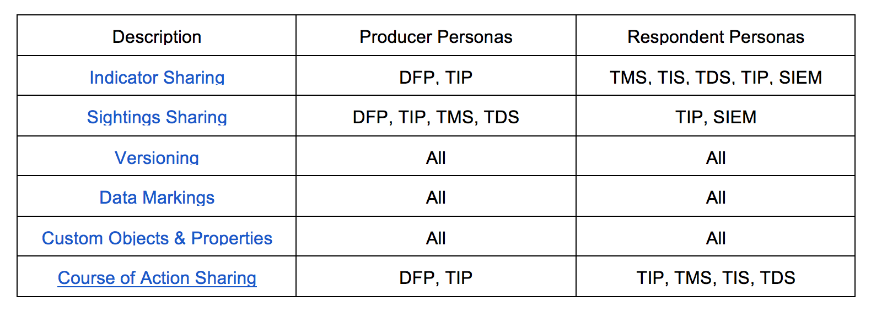
Interoperability Certification Part 1 Focus

Slide 101
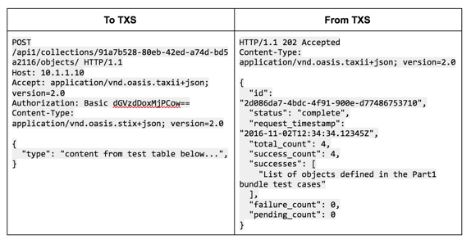
Interoperability Test Component #1: Data
Each part defines
A set of tests to performed and data for producer and consumer

Slide 102
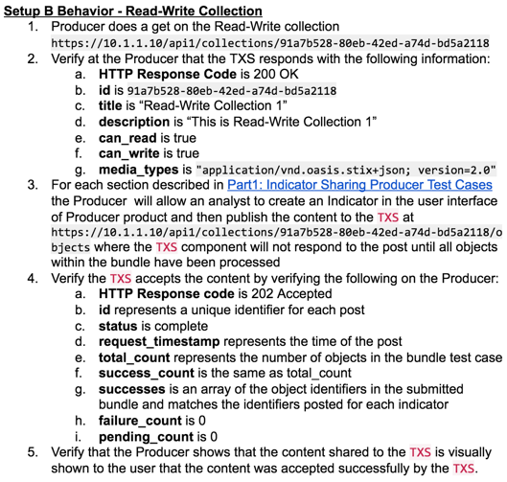
Interoperability Test Component #2: Behavior
A set of expected results & behaviors

Slide 103
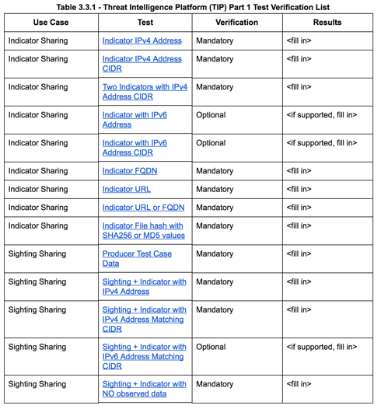
Interoperability Test Component #3: Checklists
Checklists define mandatory and optional tests for each persona

Slide 104
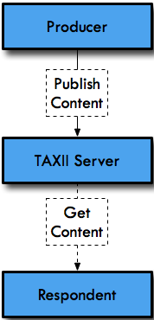
TAXII Interoperability
An organization’s software product under test may implement multiple personas
It is conceivable that a single software product instance supports
a TAXII Server
the producer
the respondent personas
For Interoperability test case documents, each specific persona verification and expected behavior is called out separately.

Slide 105
TAXII Configuration Setup
The following TAXII configuration parameters must be used
IP Address
HTTPS (not HTTP)
HTTP Basic Authentication (and associated credentials)
Server Information including
Name of server
Description
Contact
Default root
List of roots
API Root including
URL of root
Name of root
Description of root
Versions supported
Max Content supported
Allows clients to learn about the server they connect to.
- Important for operational use
- API roots advertise where the data is
Connectivity consistency across components
Secure transport
Secure Authentication
Identifies specific sharing communities
- Max content an important consideration for compatibility

Slide 106
TAXII Basic Connectivity Tests Covered
Verify that all servers and clients can communicate on a basic level and handle errors
Tests include:
Basic Get Request & Get Response
Basic API Get Request & Get Response
Missing Authorization Parameter Request & Response
Incorrect Authorization Parameter Request & Response
Incorrect API Root Info Get Returns Not Found Request & Response
Incorrect Collection Info Get Request & Response

Slide 107
TAXII Collection Tests
Separate collections
- Unvetted data vs vetted data
3 Collection Setups
Setup A: Read Only Collection; Write Only Collection
Setup B: Read-Write Collection
Setup C: Read-Only Collection
Sharing Communities that allow publication and collaboration
Intelligence publication only

Slide 108
TAXII v1 & TAXII v2 Interoperability
There is NO interoperability between STIX/TAXII version 1 & STIX/TAXII version 2
STIX/TAXII v1 is completely unrelated to STIX/TAXII v2
A vendor can support TAXII v1 and TAXII v2 on the same product instance
Be careful of clients and how they connect to TAXII v1 vs v2 endpoints

Slide 109
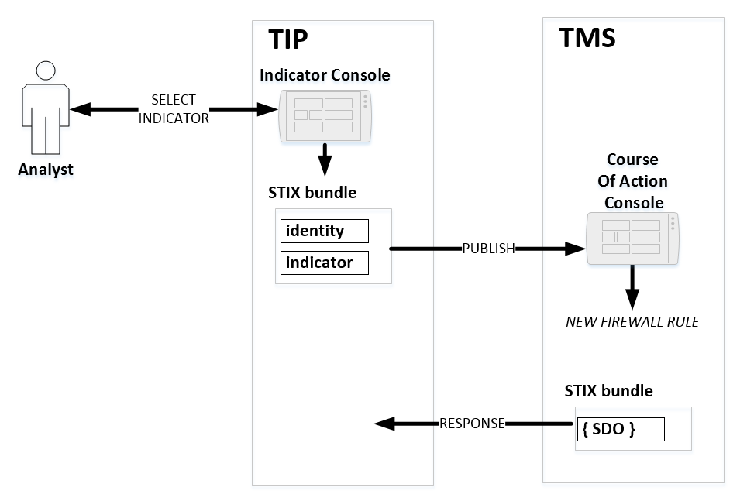
Indicator Sharing Use Case
Very common use case
Producers define what threats to look for
Technical indicators can be IPs, URLs, Domains, Hashes, etc
Consumers act on those indications
IMPORTANT Tests support for new STIX2 pattern grammar basic support

Slide 110
Indicator Sharing – Verification
Goal:
A) Verify how a producer (DFP & TIP) of Indicator intelligence generates the data correctly
B) Verify how a respondent (TIP; TMS; TDS; TIS) of Indicator intelligence correctly handles data not just parse it
Content verified:
Schema Version information
To ensure payload is correctly identifying the version of STIX being used
Created_by & Identity attribution
To ensure payload can be attributed to an intelligence source/org/team and respondent connects identity to intel
Created/Modified information
To ensure producer is publishing correct information for versioning of an object
Valid_from
To ensure producers are publishing dates that indicators are valid to consider
Pattern
To ensure the producer is able to construct correct patterns for common base indicators including: IP; FQDN; Hash; URL…etc INCLUDING simple combinatorial patterns

Slide 111
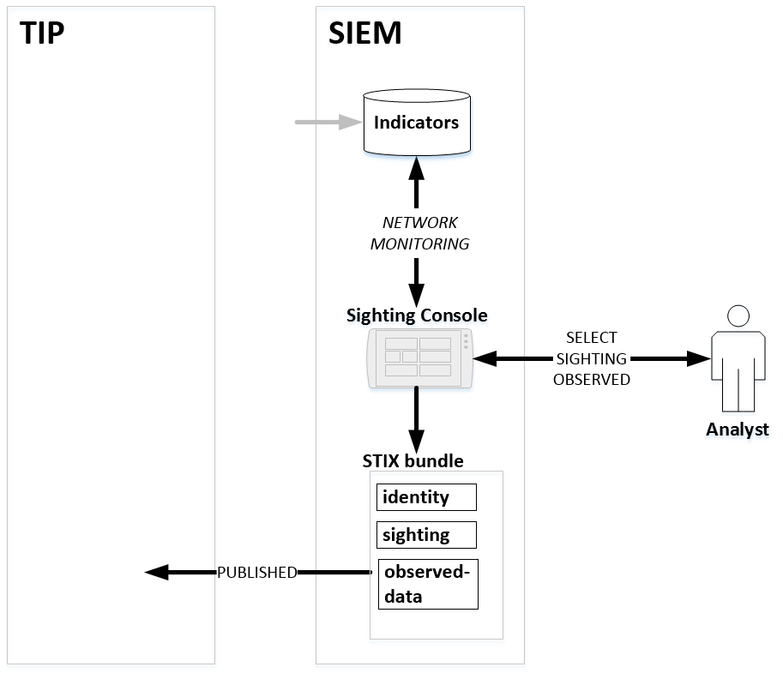
Indicator & Sighting Sharing Use Case
Very common use case
Builds on indicator sharing
Producers define what threats were observed based on indicators previously shared
Sightings include which specific observed data matched which indicators
Consumers act on those sightings
IMPORTANT Tests support for new STIX2 pattern grammar basic support

Slide 112
Sighting Sharing – Verification
Goal:
A) Verify how a producer (DFP & TIP) of Indicator intelligence generates the data correctly (same as Indicator tests)
B) Verify how a respondent (SIEM; TIP; TMS; TDS; TIS) receives Indicator intelligence and is able to produce Sighting intelligence correct that matches those indicators
Sighting & Observed_Data content verified:
Schema Version information
To ensure payload is correctly identifying the version of STIX being used
Created_by & Identity attribution
To ensure payload can be attributed to an intelligence source/org/team and respondent connects identity to intel
Created/Modified information
To ensure producer is publishing correct information for versioning of an object
First_seen; last_seen; first_observed; last_observed; number_observed
To ensure respondents are publishing dates & counts that sightings including observed_data were seen during
Sighting_of_ref
To ensure the respondent is connecting the indicator to the sighting correctly

Slide 113
Data Sharing – Collection Verification Setups
3 Use Cases identified for TAXII exchange
Applied to both data and intelligence collaboration tests
Setup A: Read & Write Separate Collections
Supports providers that can post content to a product or community that verifies content before republishing the content to others
Setup B: Read & Write Same Collection
Supports providers and respondents that publish and use intelligence without verification of the intelligence at the TAXII server
Setup C: Read Only Collection
Supports providers that wish to publish content but do not allow any feedback on that published content or allow additional content to be pushed

Slide 114
Q&A

Slide 115
STIX/TAXII 2.1 and Beyond

Slide 116
Current Timeline
Refining CTI TC processes
STIX / TAXII 2.1 Development
2Q 2018
4Q2018
1Q 2018
3Q2018
STIX / TAXII 2.1 Development
Finalizing STIX / TAXII 2.1

Slide 117
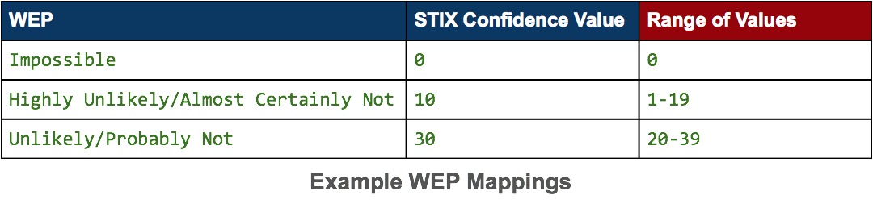
New Feature: Confidence
A new, optional property on all STIX Domain Objects.
Definition: The confidence property identifies the confidence that the creator has in the correctness of their data. The confidence value MUST be a number in the range of 0-100.
Examples
An Indicator with a confidence value of 100 = high confidence that the indicator pattern detects the malicious activity that it claims to
A Campaign with a confidence value of 50 = medium confidence that the campaign is made up of a related set of adversarial behaviors
STIX 2.1 includes a standard set of mappings between existing confidence scales and STIX confidence values (including range)
None/Low/Medium/High
0-10 scale
Admiralty Credibility
Words of Estimative Probability (WEP)
DNI Scale

Slide 118
New Feature: Internationalization
Goals:
Allow STIX content to be translatable into different languages so that you can have publishers creating content in several languages and third party translation services for STIX content.
Allow for the identification of which language specific STIX content is in.
New optional lang property on all STIX SDOs: indicates what language the content is in.
For example: a campaign object could be published with a lang value of Japanese to indicate that the name, description, and other human text fields are in Japanese.
New optional lang property in the granular-marking type: indicates that certain fields in the object are in a particular language.
For example: certain fields in an object are in English while others are in Japanese.
New language-content object: provide additional languages (translations) for other STIX objects.
For example: one could publish a campaign in Japanese and then provide a language-content object with that same text in English.

Slide 119
Updated SDO: Malware
Malware characterizes Malware Instances or Malware Families, including identifying information, metadata, and data that may be derived from various forms of malware analysis.
The STIX 2.0 Malware SDO was a stub that could only capture malware names
For STIX 2.1 the Malware SDO has been updated to natively capture:
Sample metadata (e.g., file hashes, etc.)
Field data (first seen/last seen)
Execution & Implementation metadata
Static analysis results
Dynamic analysis (i.e., sandboxing) results
AV classification results
STIX 2.1 Malware SDO allows for the differentiation of Malware Instances and Malware Families

Slide 120
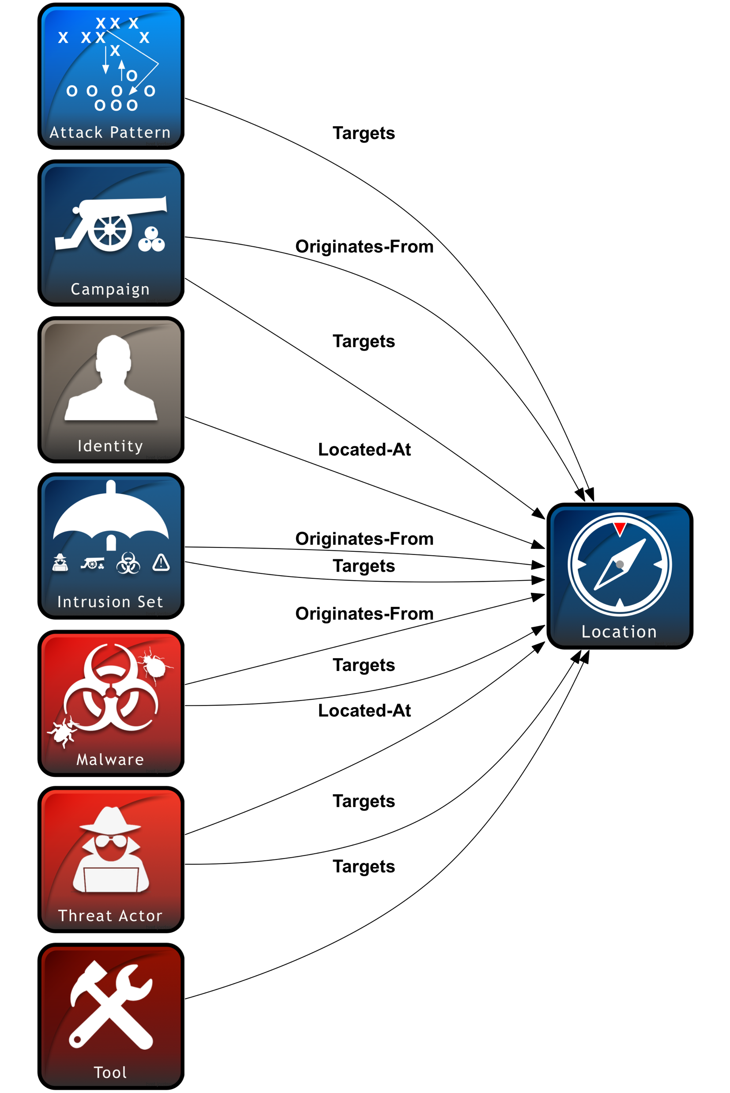
New SDO: Location
A Location represents a geographic location. The location may be described as any, some or all of the following: region, civic address, or latitude and longitude.
Examples
Relationships
North America
New York, USA
38.833882, -104.821363

Slide 121

New SDO: Note
A Note is a comment or note containing informative text to help explain the context of one or more STIX Objects or to provide additional analysis that is not contained in the original object.
Examples
Relationships
A Note indicating the steps used by an analyst to investigate a particular Campaign
A Note stating that a particular Indicator was automatically generated by a malware sandbox
N/A – there are no top-level relationships between the Note Object and other Objects.
Instead, the Note Object has an embedded relationship that can point to any STIX Object (including other relationships).

Slide 122

New SDO: Opinion
An Opinion is an assessment of the correctness of the information in another STIX Object.
Opinion
Examples
Relationships
An Opinion about Indicator Foo, stating that it does not detect what it claims to
An Opinion about Campaign Bar, stating that it was based on false assumptions
N/A – there are no top-level relationships between the Opinion Object and other Objects.
Instead, the Opinion Object has an embedded relationship that can point to any STIX Object (including other relationships).

Slide 123
TAXII 2.1: What’s New and Planned
Additional Endpoints
Pagination
Query
TAXII Channels (proposed)

Slide 124
Resources: If you want to…
Join the CTI Users mailing list
Subscribe by sending a blank email to cti-users-subscribe@lists.oasis-open.org
Get an overview and examples of STIX/TAXII:
https://oasis-open.github.io/cti-documentation/
Read the actual specifications:
https://oasis-open.github.io/cti-documentation/resources#stix-20-specification
Learn more about the CTI TC:
https://wiki.oasis-open.org/cti/
Access STIX/TAXII APIs and tools:
https://github.com/oasis-open?q=cti-
Join OASIS and the CTI TC:
https://www.oasis-open.org/join/ or email join@oasis-open.org

